Slide 1
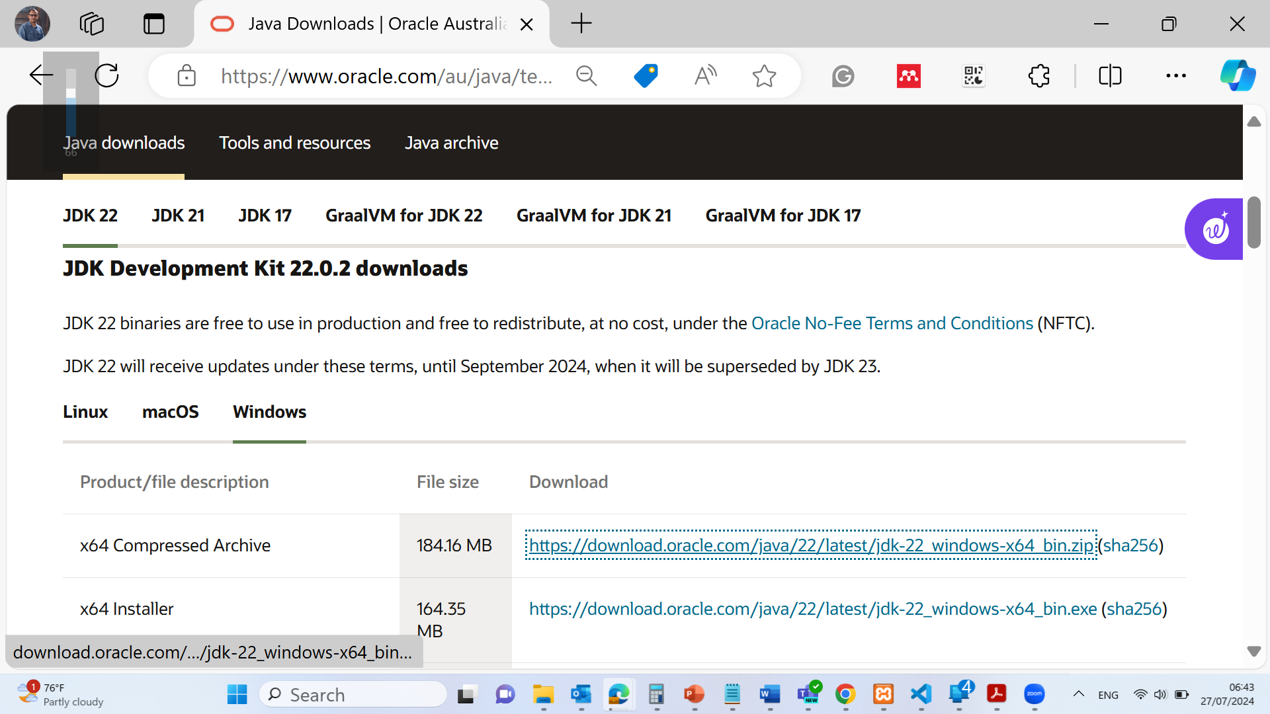
Java Installation:
Download and install the idk package https://www.oracle.com/au/java/technologies/downloads/#jdk22-windows

Slide 2
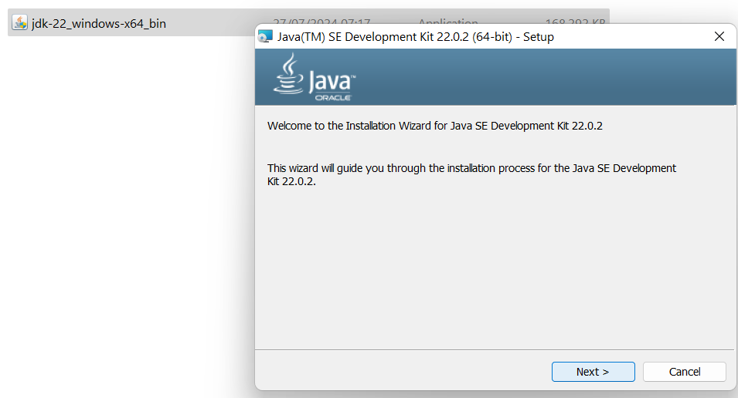
Java Installation:
Download and install the idk package https://www.oracle.com/au/java/technologies/downloads/#jdk22-windows

Slide 3
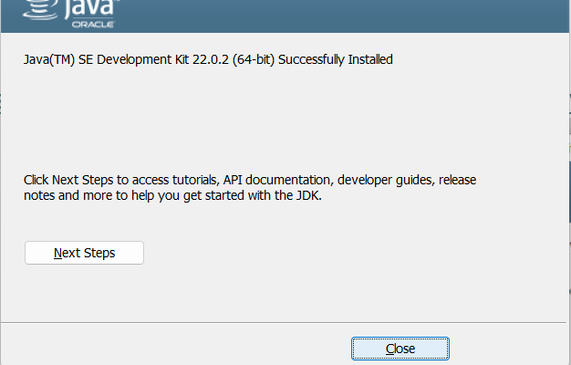
Java Installation:
Download and install the idk package https://www.oracle.com/au/java/technologies/downloads/#jdk22-windows

Slide 4
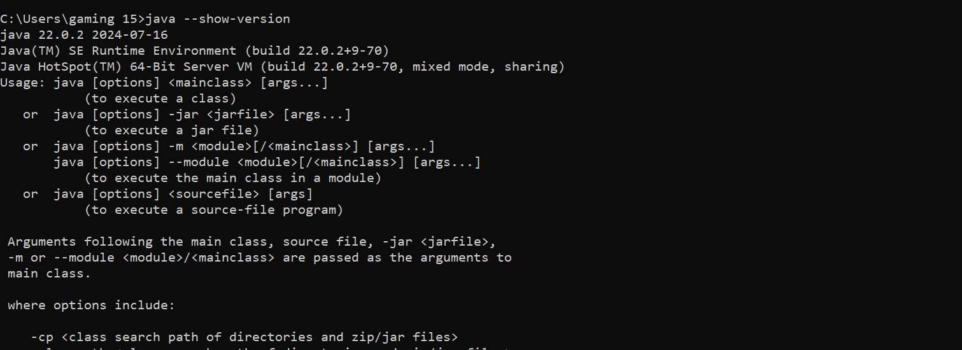
Java Installation:
Command Prompt Windows / Terminal in MAC: java –show-version

Slide 5
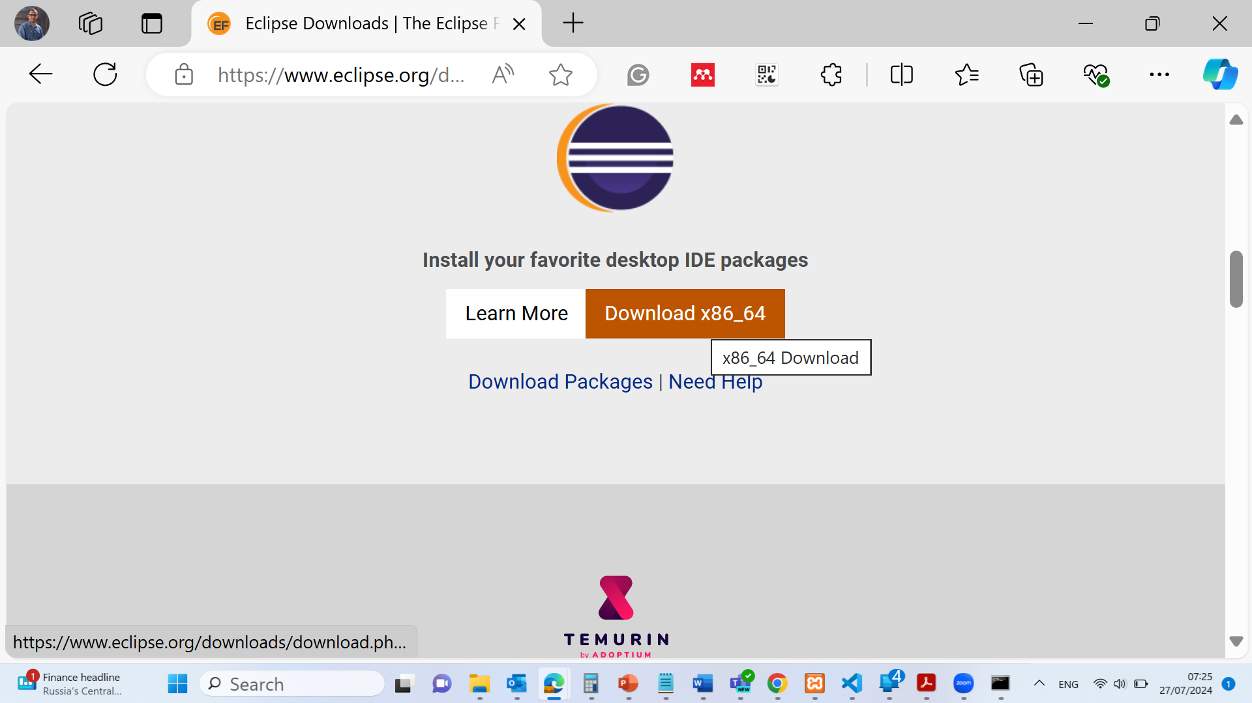
Java Installation:
Download Eclipse Software https://www.eclipse.org/downloads/

Slide 6
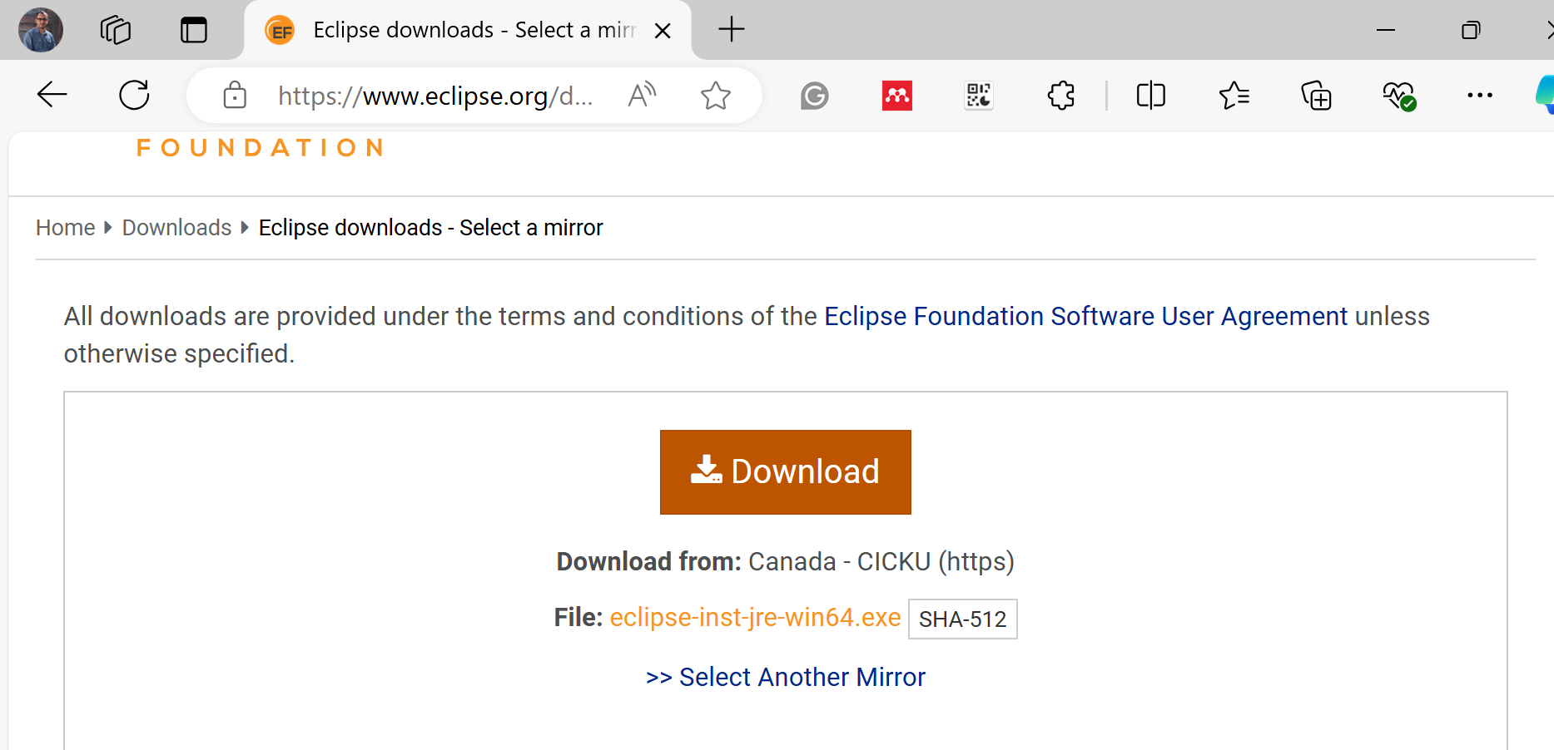
Java Installation:
Download Eclipse Software https://www.eclipse.org/downloads/

Slide 7
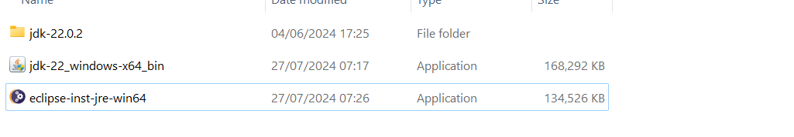
Java Installation:
Install Eclipse Software https://www.eclipse.org/downloads/

Slide 8
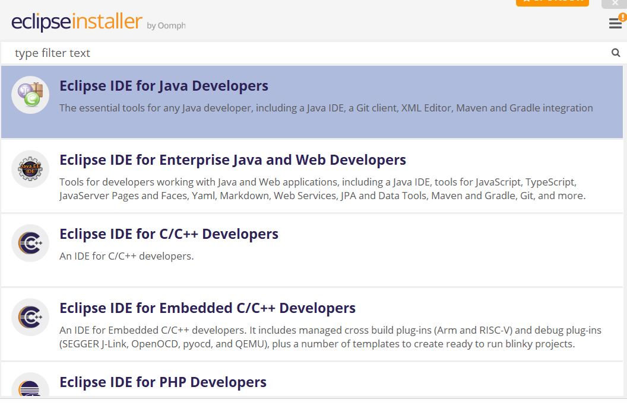
Java Installation:
Install Eclipse Software https://www.eclipse.org/downloads/

Slide 9
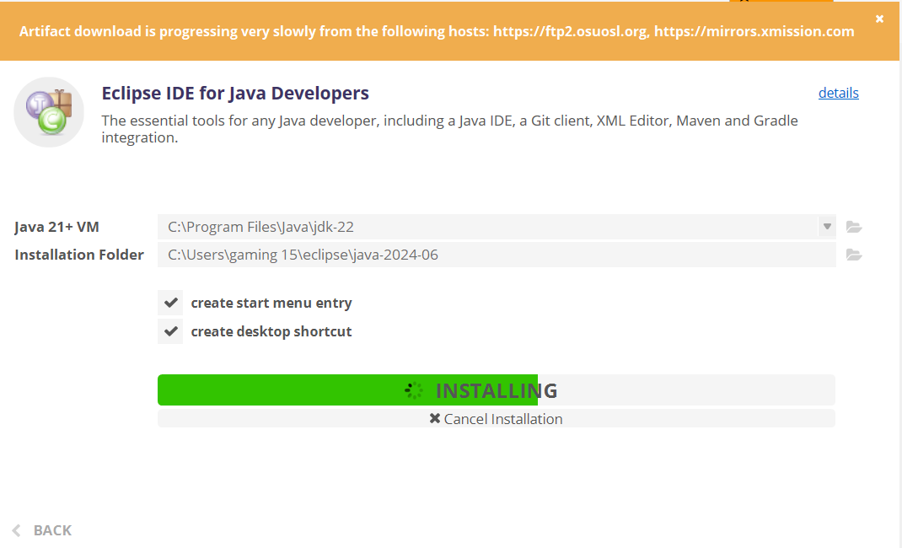
Java Installation:
Install Eclipse Software https://www.eclipse.org/downloads/

Slide 10
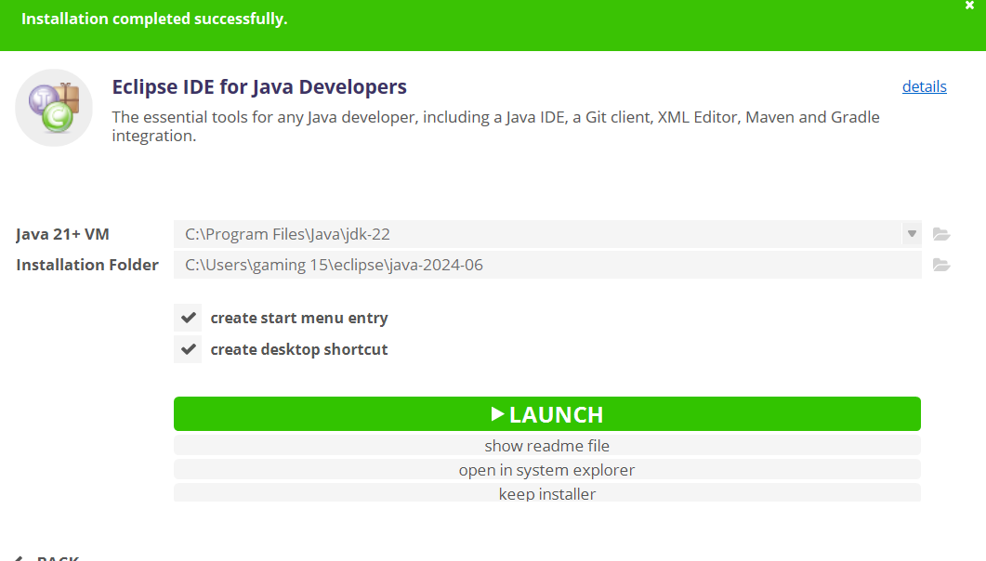
Java Installation:
Install Eclipse Software https://www.eclipse.org/downloads/

Slide 11
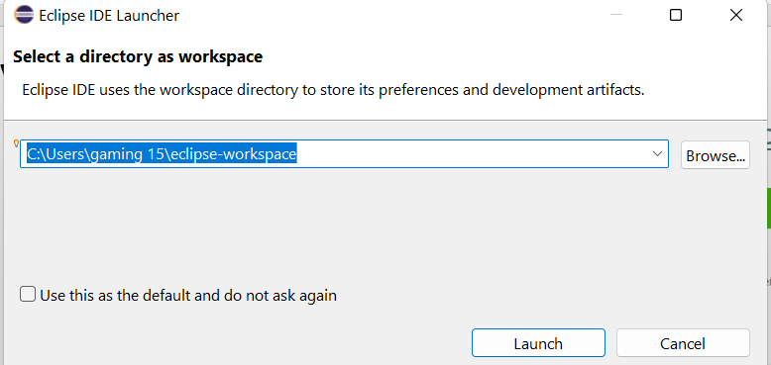
Java Installation:
Install Eclipse Software https://www.eclipse.org/downloads/

Slide 12
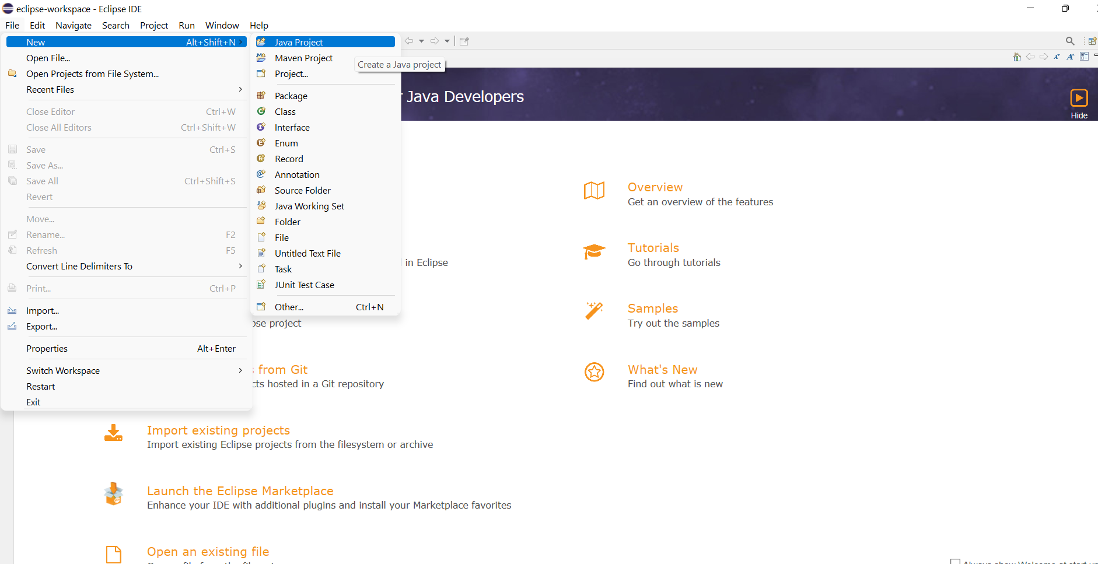
Java Installation:
Install Eclipse Software https://www.eclipse.org/downloads/

